Slide 1
Accident Severity Prediction

Slide 2
Predicting accidents and severity prior to the event can save lives and costs
There are 6.734 million crashes that occurred in 2018. Over 2.7 million people have been injured resulting in over 36,000 fatalities.
If we can predict a crash prior to the event and intimate the driver, we can save lives (fatalities) and also avoid cost of damage
Drivers, state transport and traffic departments, and auto insurers will benefit from such prediction

Slide 3
Data source
Data is provided by Seattle Police Department on all collisions and their traffic records.
The data is on all collision types taken place in Seattle since 2004 to present date.
The data contains only two severity types - 1 for property damage and 2 for injury. But the metadata dictionary contains other values which are not represented in the data.

Slide 4
Data cleaning
Columns with missing values were either dropped, replaced with most frequent value or replace with ‘N’ for columns having 1 unique value i.e. ‘Y’s
Columns containing post-collision data dropped as not useful in predicting collision prior to actual event
Seattle specific data is removed
Duplicative columns and rows were removed.
Data was imbalanced (130,549 Severity 1 rows and 57,786 (<30%) of Severity 2 rows ) hence Severity 2 rows have been up-sampled

Slide 5
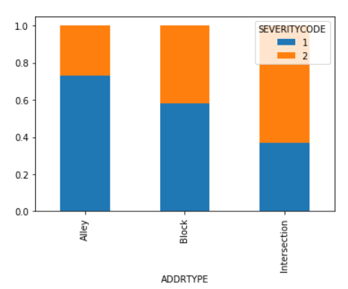
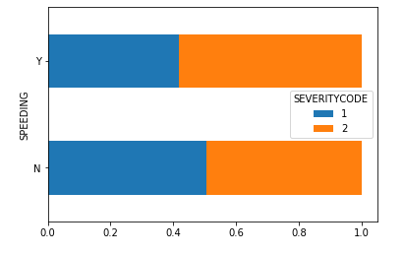
Higher Probability Of Severity 2 Collision At An Intersection
Higher Probability Of Severity 2 Collision if the driver is speeding

Slide 6
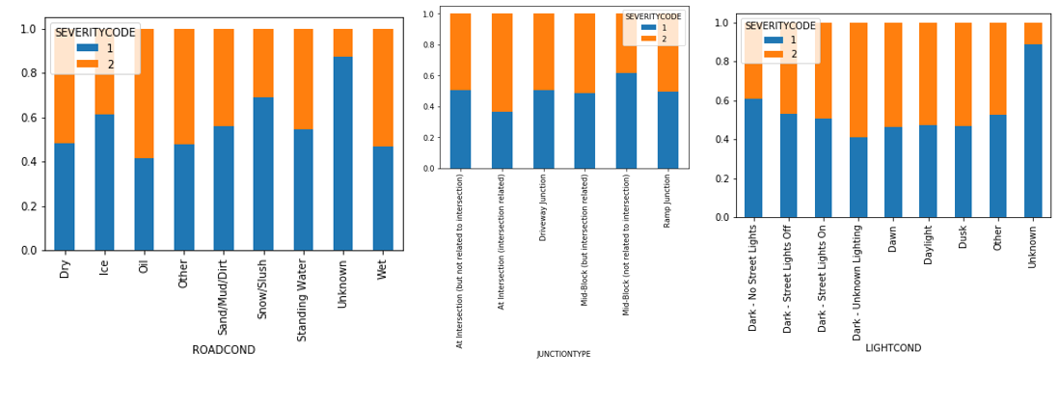
No Significant Relationship Between Severity With Individual Variables – Junction Type, Road Conditions And Light Conditions

Slide 7
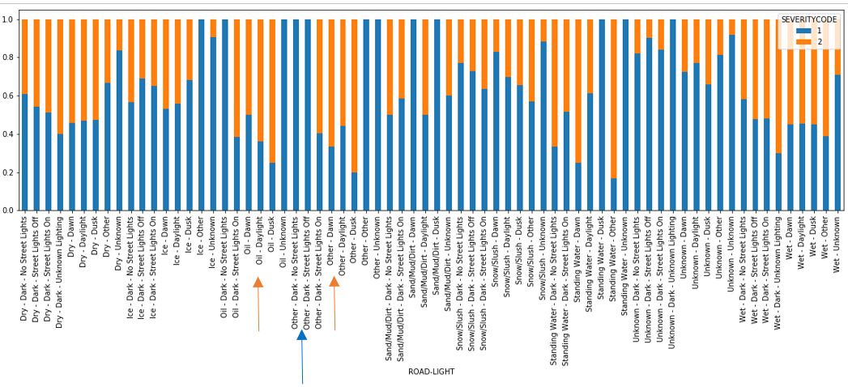
But combination of road and light conditions variables reveals some highly dominated Severity 1 and 2 conditions.

Slide 8
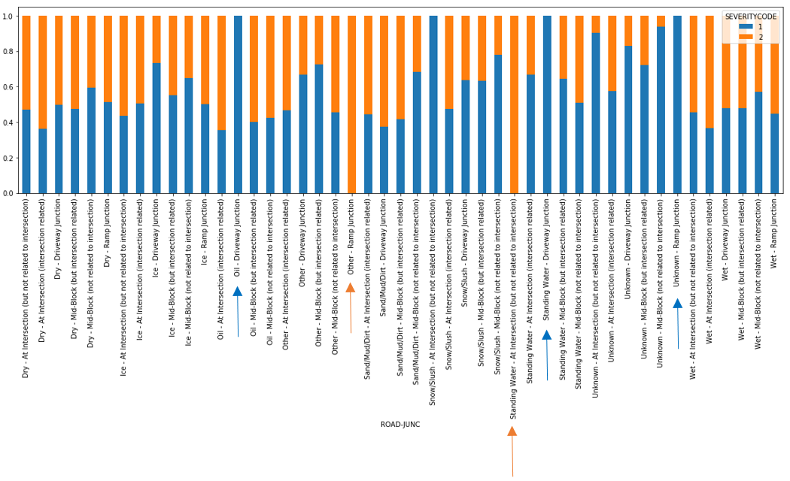
Combination of road conditions and junction types variables reveals some highly dominated Severity 1 and 2 conditions.

Slide 9
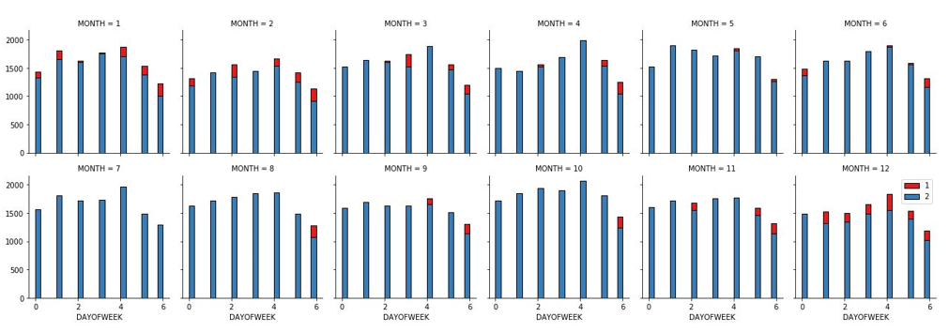
Severity 1 collisions are concentrated in the winter months i.e. December, January and February and relatively more on Sundays compared to other days.

Slide 10
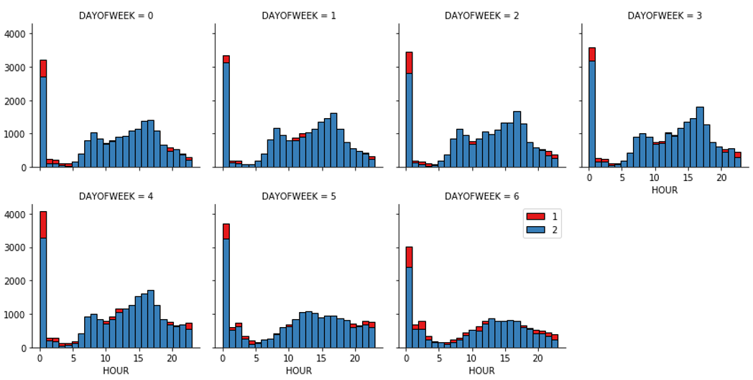
Severity 1 collisions are concentrated at midnight and hours before and after it i.e. the night-time

Slide 11
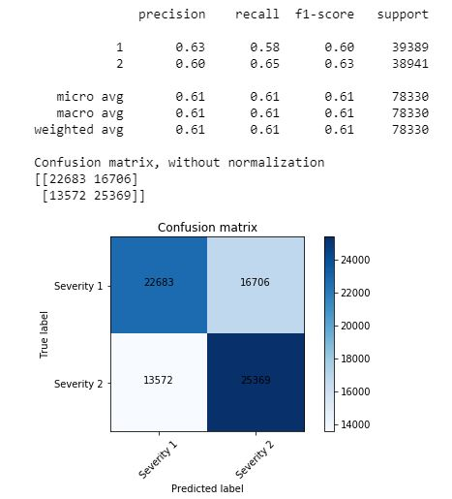
Machine Learning Model
Classification models were used for prediction
Random Forest Model performed best
Accuracy: 0.6134
F1 score: 0.6129

Slide 12
Conclusion and next steps
Built classification model to predict the severity of a collision
There is still room for improvement based on the accuracy score of our best model
Can look at obtaining for other severity levels as mentioned in the metadata
Haven’t predicted probability of an accident – can look at data with lower probability of accident

